Slide 1

Library Management Database System
Kabul University
Created by: Murtaza Hussaini , Jawid Muradi & Farid wardak
Year: May 2025

Slide 2
What is a library?
A library is an organized collection of books and other informational resources made accessible to a community for reading, study, and reference.
Libraries often include digital systems for managing books, users, staff, borrowing, returning, and storage.

Slide 3
Why Use a Database for a Library?
Efficient Management: Manage large numbers of books, students, and staff easily.
Accurate Tracking: Keep exact records of issued and returned books.
Quick Search: Instantly search for books and member info.
Avoid Redundancy: Prevent duplicate and inconsistent data.
Security: Protect data with controlled access.
Reporting: Generate reports on book usage, overdue items, and staff actions.
Reduce Human Errors: Minimize mistakes in issuing, returning, and updating records.

Slide 4
ER Diagram Overview
The Entity-Relationship (ER) Diagram includes entities such as Student, Faculty, Book, Registration, Transactions and more. It shows how these entities relate to each other, using primary and foreign keys to establish connections.

Slide 5
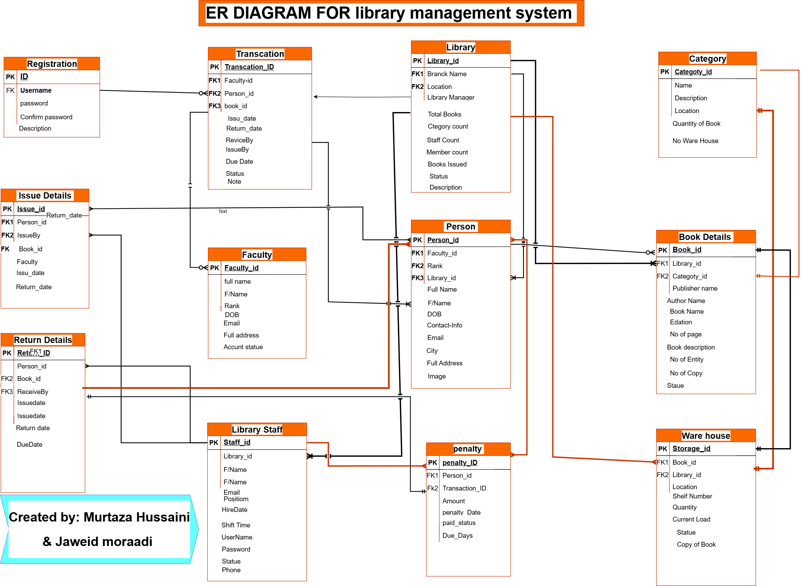

Slide 6
Registration Table
Stores login credentials for users.
Fields:
- ID (PK)
- Username (FK)
- Password
- Confirm Password
- Description
Has a relationship with Transaction table
1:1

Slide 7
Person Table
Stores details of Peoples who use the library.
Fields:
- Person_id (PK)
- Faculty_id (FK1)
- Rank (FK2)
- Full Name
- F/Name
- DOB
- Contact-info
- Email
- City
- Full Address
- Image
Relationship with Book details table
1:M optional
Relationship with penalty table
M:M mandatory
Relationship with Issue details table
M:M
Relationship with Return details table
M:1 mandatory
Relationship with Library table
M:1
Relationship with Transaction table
M:1

Slide 8
Faculty Table
Stores information about faculty members.
Fields:
- Faculty_id (PK)
- Full name
- F/Name
- Rank
- DOB
-Email
- Full Address
- Account Statue
Has a relationship with Transaction table
M:1 optional

Slide 9
Transaction Table and relationship
Records the people transactions.
Fields:
- Transaction_ID (PK)
- Faculty-id (FK1)
- Person_id (FK2)
- book_id (FK3)
Issue Date
- Return Date
Has a relationship with Faculty Table 1:M optional
Has a relationship with Person table
1:M Mandatory
Has a relationship with Registration table M:1 Optional

Slide 10
Book Details Table ( Main Table)
Contains details of all books in the library.
Fields:
- Book_Id (PK)
- Book Name
- Author Name
- Publisher Name
- Edition
- Book cost
- No. of pages
- Book Description
- No of Entity
- No of copy
- Statue
The book detail is the main table in ER Diagram:
Relationship with Person table M:1 Optional
Relationship with Ware house table 1:1 Mandatory

Slide 11
Issue Details Table
Logs each time a person borrows a book.
Fields:
- Issue_Id (PK)
- Person_id (FK1)
- Book_Id (FK2)
- IssueBy (FK3)
Faculty
Issue Data
Return Data
Has a relationship with Person table
M:M
Has a relationship with Library Staff
M:1

Slide 12
Return Details Table
Logs return of books by Person.
Fields:
- Return_Id (PK)
Person_id (FK1)
- Book_Id (FK2)
- ReceiveBy (FK3)
- Return Date
Due Data
Has a relationship with Library Staff
M:1
Has a relationship with penalty
1:1 Mandatory
Has a relationship with person table
1:M

Slide 13
Category Table
Books categories in subjects
Fields:
- Category_id (PK)
- Name
- Location
- Description
Quantity of Book
No. ware House
Relationship with Book details
1:1 Mandatory
Relationship with ware house
1:1 mandatory ‌

Slide 14
Ware House Table
How much book we have:
Fields:
- Storage_id (PK)
- Book_id (FK)
- Location
- Shelf Number
Quantity
Current load
Statue
Copy of Book
Relationship with Book Details
1:1 Mandatory
Relationship with Category
1:1 Mandatory

Slide 15
Relationships
Library Table (Main table)
Purpose: Defines each library branch.
Fields:
Library_id (PK)
Branch Name
Location
Library Manager
Total Books
Category Count
Staff Count
Member Count
Books Issued
Status
Description
.
Relationships:
Person table 1:M mandatory
Book details table 1:M mandatory
Ware House table 1:M mandatory
Library Staff table 1:M mandatory
Transaction table 1:1

Slide 16
Conclusion
Library Staff Table
Purpose: Contains details about library workers.
Fields:
Staff_id (PK)
Library_id (FK)
Full Name
Email
Position
Hire Date
Shift Time
Username
Password
Status
Phone
This database efficiently handles user registrations, book inventories, and borrow/return activities. It uses well-defined relationships to ensure data integrity and is scalable for future additions like fines, notifications, or user analytics.
Relationships:
FK to Library
Referenced by Return Details
via ReceiveBy
Explanation: Records all employees involved in library operations.

Slide 17
Penalty Table
Purpose: Handles penalties for late returns.
Fields
penalty_ID (PK)
Person_id (FK)
Transaction_ID (FK)
Amount
Penalty Date
Paid Status
Due Days
Relationships:
FK to Person, Transaction
Explanation: Tracks fine amounts and payment statuses for delays

Slide 18
Conclusion
The Library Management System diagram provides a clear and structured view of how a university library operates.
It shows the interaction between students, librarians, books, and the database system.
Our goal was to present a simplified yet functional model that can be used as a foundation for real system implementation or academic understanding.
This system helps in improving library efficiency, data tracking, and user management in a digital environment.

Slide 19
Want to Learn More?
If you’re interested in exploring the full diagram and the complete presentation, or want more information:
👉 Visit our GitHub project:
https://github.com/hussaini021/Library_management
There, you’ll find:
The full diagram of Structure in draw.io file
The full system diagram (image file)
This presentation file
📄 A detailed README explaining the purpose and contents
Feel free to check it out, give feedback, or use it for learning!

